Slide 1
Logic Gates, Logic Circuits & Boolean Algebra
Lecture 9

Slide 2
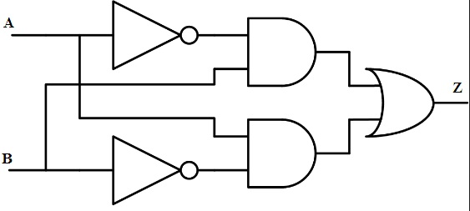
Logic Gates
Logic gates are electronic circuits that operate on one or more input signals to produce standard output signal.
Some of the most basic and useful logic gates are -
AND,
OR,
NOT,
NAND and
NOR gate

Slide 3
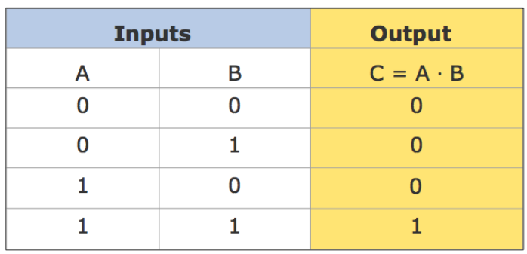

AND Gate
Generates an output signal of 1 only if all input signals are also 1

Slide 4
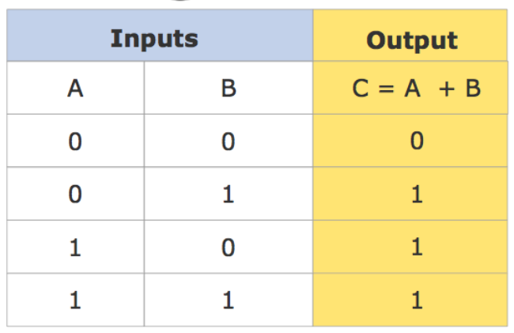
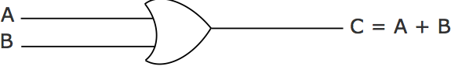
OR Gate
Generates an output signal of 1 if at least one of the input signals is also 1

Slide 5
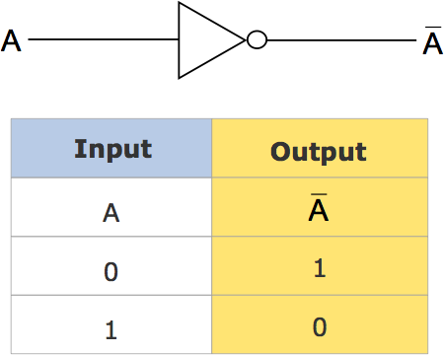
NOT Gate
Generates an output signal, which is the reverse of the input signal

Slide 6
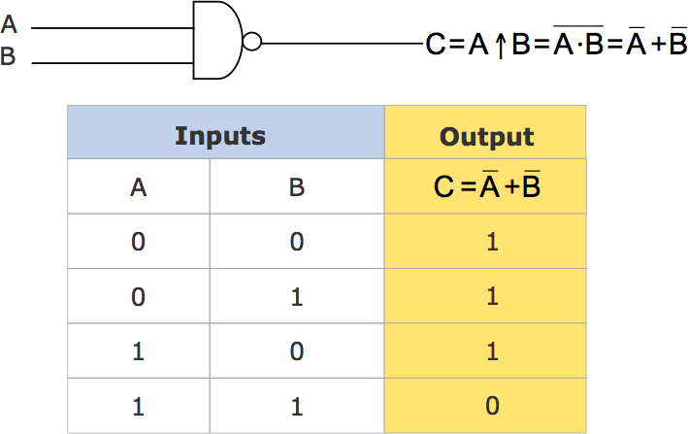
NAND Gate
Complemented AND gate. Generates an output signal of:
① 1 if any one of the inputs is a 0
② 0 when all the inputs are 1

Slide 7
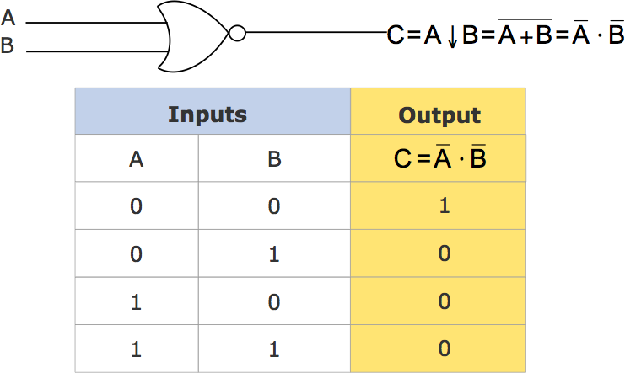
NOR Gate
Complemented OR gate. Generates an output signal of:
① 1 only when all inputs are 0
② 0 if any one of inputs is a 1

Slide 8
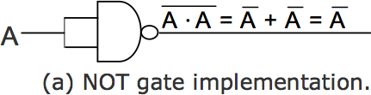
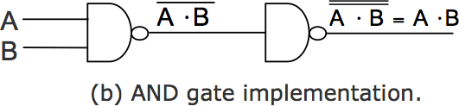
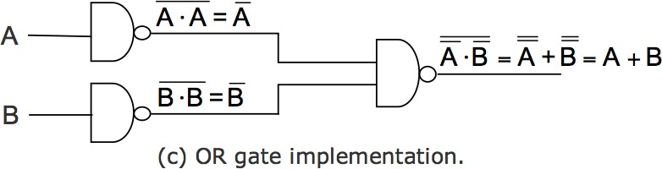
Universal NAND Gate
NAND gate is an universal gate, it is alone sufficient to implement any Boolean expression
To understand this, consider:
Basic logic gates (AND, OR, and NOT) are logically complete. Sufficient to show that AND, OR, and NOT gates can be implemented with NAND gates

Slide 9
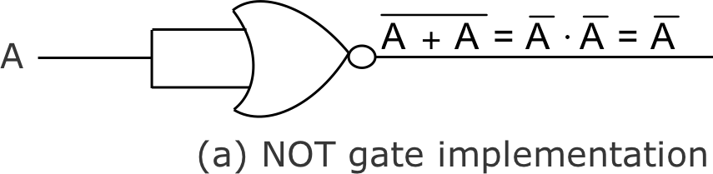
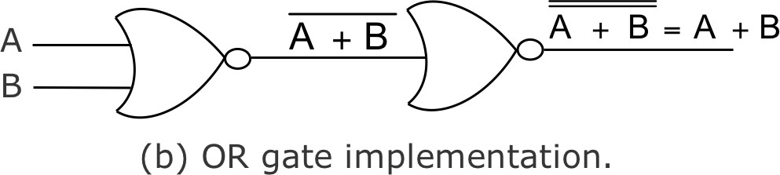
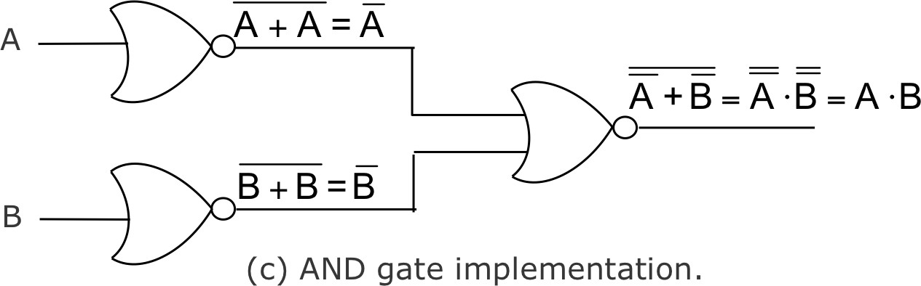
Universal NOR Gate
NOR gate is an universal gate, it is alone sufficient to implement any Boolean expression
To understand this, consider:
Basic logic gates (AND, OR, and NOT) are logically complete. Sufficient to show that AND, OR, and NOT gates can be implemented with NOR gates

Slide 10
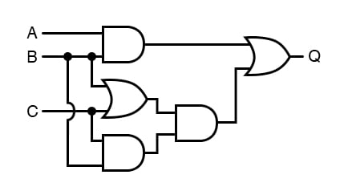
Logic Circuits
When logic gates are interconnected to form a gating / logic network, it is known as a combinational logic circuit
The Boolean algebra expression for a given logic circuit can be derived by systematically progressing from input to output on the gates
The three logic gates (AND, OR, and NOT) are logically complete because any Boolean expression can be realized as a logic circuit using only these three gates

Slide 11
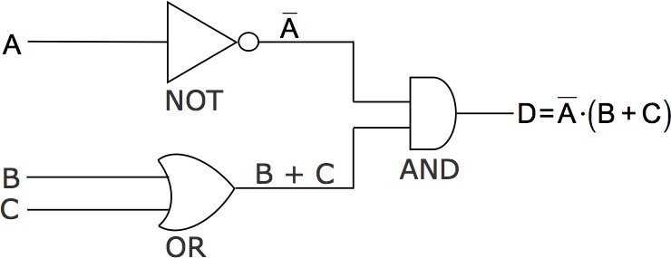
Finding Boolean Expression of a Logic Circuit
(Example 1)

Slide 12
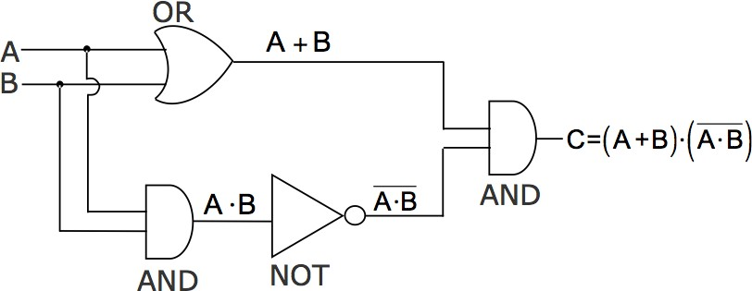
Finding Boolean Expression of a Logic Circuit
(Example 2)

Slide 13
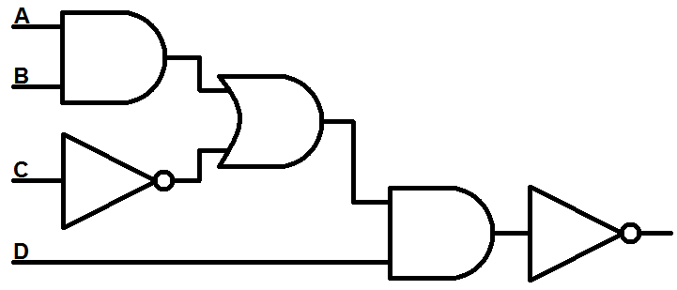
Finding Boolean Expression of a Logic Circuit
(Example 3)

Slide 14
Boolean Algebra
Use of Binary Digit: Boolean equations can have either of two possible values, 0 and 1
Logical Addition: Symbol ‘+’, also known as ‘OR’ operator, used for logical addition. Follows law of binary addition
Logical Multiplication: Symbol ‘. ’, also known as ‘AND’ operator, used for logical multiplication. Follows law of binary multiplication
Complementation: Symbol ‘-’, also known as ‘NOT’ operator, used for complementation. Follows law of binary compliment

Slide 15
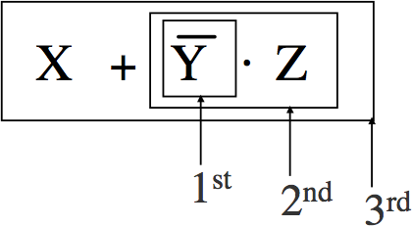
Operator Precedence
Each operator has a precedence level
Higher the operator’s precedence level, earlier it is evaluated
Expression is scanned from left to right
First, expressions enclosed within parentheses are evaluated
Then, all complement (NOT) operations are performed
Then, all ‘⋅’ (AND) operations are performed
Finally, all ‘+’ (OR) operations are performed

Slide 16
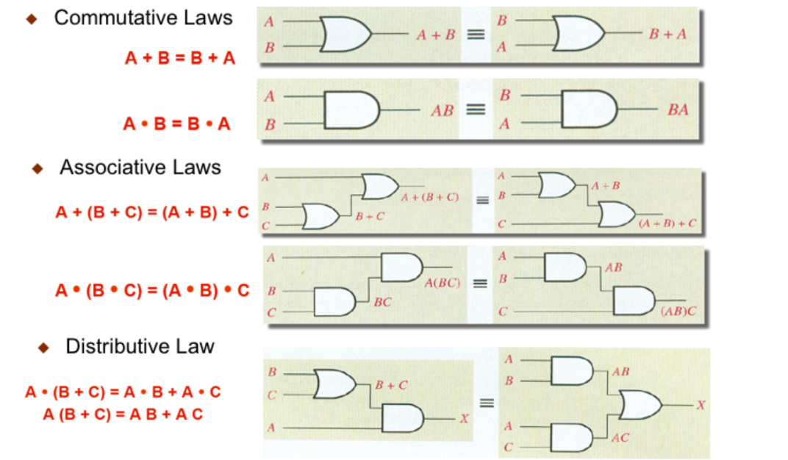
Laws of Boolean Algebra

Slide 17
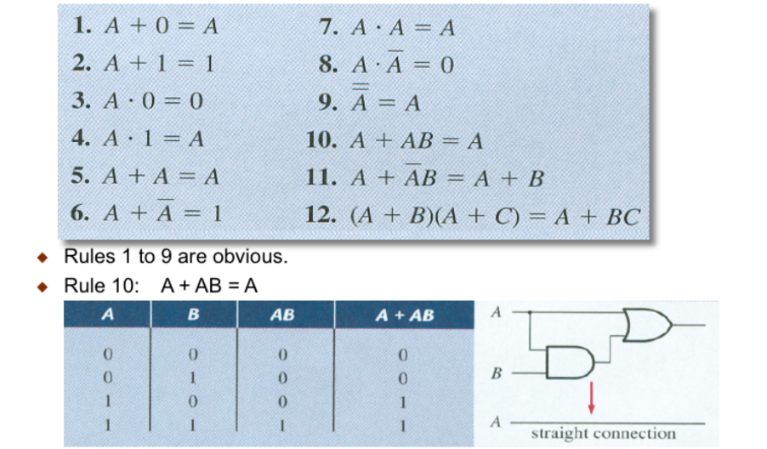
Rules

Slide 18
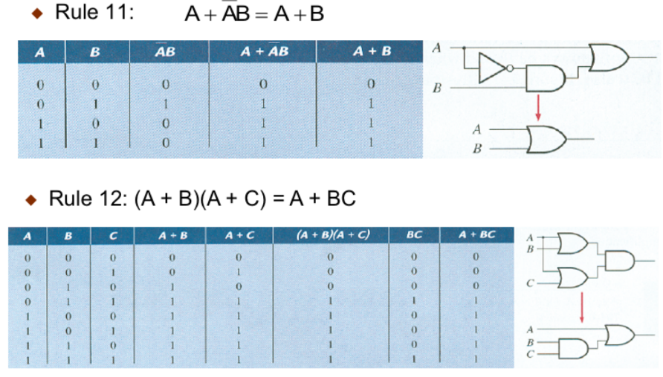
Rules

Slide 19
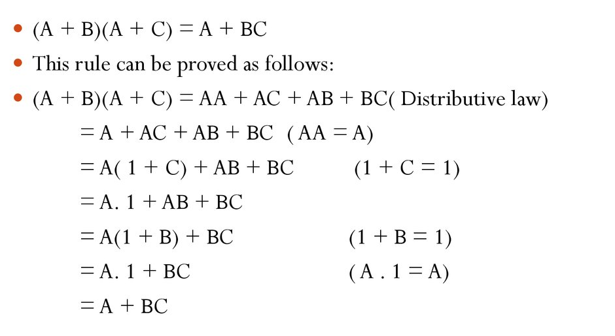
Simplify Boolean Equation

Slide 20
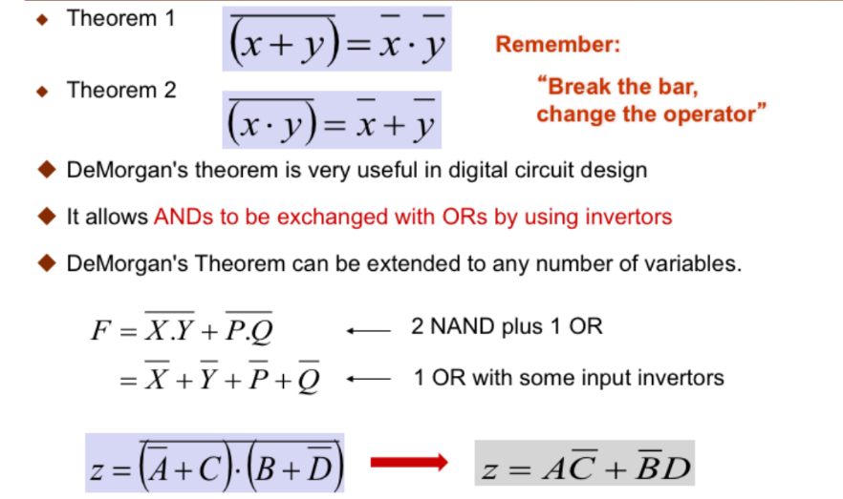
DeMorgan’s Theorem

Slide 21
That’s all for today………

